Slide 1
Life Sciences Trainers & Educators Network (LTEN)
Five Decades of Serving the Healthcare Training Community

Slide 2
LTEN’s Vision, Mission & Value Proposition
Vision Life Sciences Trainers & Educators Network—Advancing Global Life Sciences Learning
Mission LTEN is the essential resource for life sciences trainer education and networking; enabling members to harness their collective knowledge, apply leading-edge technology and deliver world class learning
Value Proposition Only LTEN specializes in meeting the needs of life sciences learning professionals. LTEN shares the knowledge of industry leaders, provides insight into new technologies, offers innovative solutions and communities of practice that grow careers and organizational capabilities.
Notes:
David

Slide 3
Celebrating 50 Years of Training Excellence
LTEN was founded in 1971 to enhance the skills of life science educators and create a community of health care training professionals
50 years later, that original mission remains the cornerstone of our innovations and resources

Slide 4
LTEN Timeline

Slide 5
LTEN Member Benefits at-a-Glance
Find Knowledge,
Strategies & Insights
Focus on Training Magazine and Bonus Focus Web Articles
IndustryBrief – Curated Weekly News from Across the Training & Healthcare Industry
Virtual & In-Person Workshops$
Live & On-Demand Webinars
Partner Previews
LTEN Talks Podcasts
Reference Materials from LTEN Conferences
Connect with
Your Community
Live & Virtual Networking Mixers
Annual Conference $
Learning Executive Series*
Member Directory
Supplier Directory
Volunteer Opportunities
Leadership Opportunities
Advance Your Career
LTEN Career Center $
eLearning Lounge Microlearning $
LTEN Excellence Awards $
A Network of Peers
Professional Skill Development for Every Experience Level
Discounts and Freebies for LTEN Members
More than 300+ Archived Articles , Webinars and Videos on demand - Every L&D Topic!
$ Additional cost; discounts available for LTEN Members
*By Invitation only

Slide 6
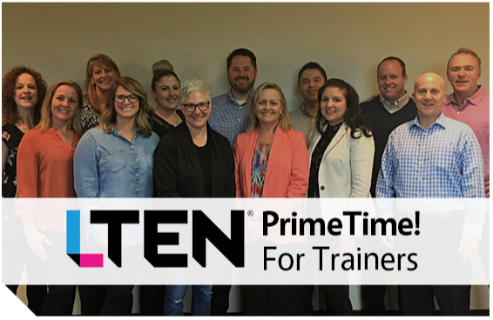
2023 Certificate Programs
LTEN 6Ds Workshop
Learn a proven process to design, deliver and measure training and ensure learning transfer.
PrimeTime! For Trainers—Core Class
Master adult learning concepts, effective facilitation, audience engagement, and troubleshooting.
PrimeTime! For Trainers—Master Class
An advanced course for trainers who want to ignite participation, interaction and willing experimentation even among reluctant participants.
Science and Practice of Modern Learning and Assessment
Learn to develop an evidence-based approach to delivering learning, integrating learning technology and assessments.

Slide 7
LTEN Events Calendar 2023
PrimeTime! For Trainers Core
March 13-15, 2023 – San Diego, CA
May 15-18, 2023 – Virtual
September 11-13, 2023 – Cambridge, MA
December 4-6, 2023 – Short Hills, NJ
PrimeTime! For Trainers Masters
December 7-8, 2023 – Short Hills, NJ
6Ds Workshop
March 28-29, 2023 – Princeton, NJ
October 11-12, 2023 - Chicago, IL
Annual Conference
June 12-15, 2023 – Phoenix, AZ
Science of Learning and Assessment
May 2023 – Virtual (Proposed)
Networking Mixers
March 14, 2023 – San Diego, CA
March 28, 2023 – Princeton, NJ
September 12, 2023 - Cambridge, MA
October 11, 2023 – Chicago, IL
October 27, 2023 – Virtual
December 5, 2023 – Short Hills, NJ

Slide 9
LTEN eLearning Lounge
A Comprehensive Solution for Onboarding and Refreshing Knowledge on Life Sciences Learning & Development Core Competencies
Bite-sized modules focus on specific topics – most lessons are 15-25 minutes long
On-demand learning – perfect for busy schedules, ensuring you learn quickly so that you can immediately apply what you learn on the job
Choose from 15 modules – mix and match lessons, select the complete bundle or the Field Trainer Bundle (7 courses chosen by our Field Trainer Committee)
Includes comprehensive job aids, action guides, templates and coaching guides to reinforce each lesson
Affordable – member discounts and volume discounts
Modules:
Creating Inclusive Learning Experiences
Your Role as a Life Science Trainer
How to Work in a Corporate Environment
How to Work with a Supplier Partner
Time Management Strategies for Success
Project Management
Performance Consulting
Introduction to Instructional Design and Design Models
Adult Learning Principles and Learning Styles
Learning Retention Strategies
Determining the Best Delivery Approach
Participant Engagement Strategies
Learning Styles and Modalities
Planning for building a workshop
Learning Measurement & Metrics Concepts

Slide 11
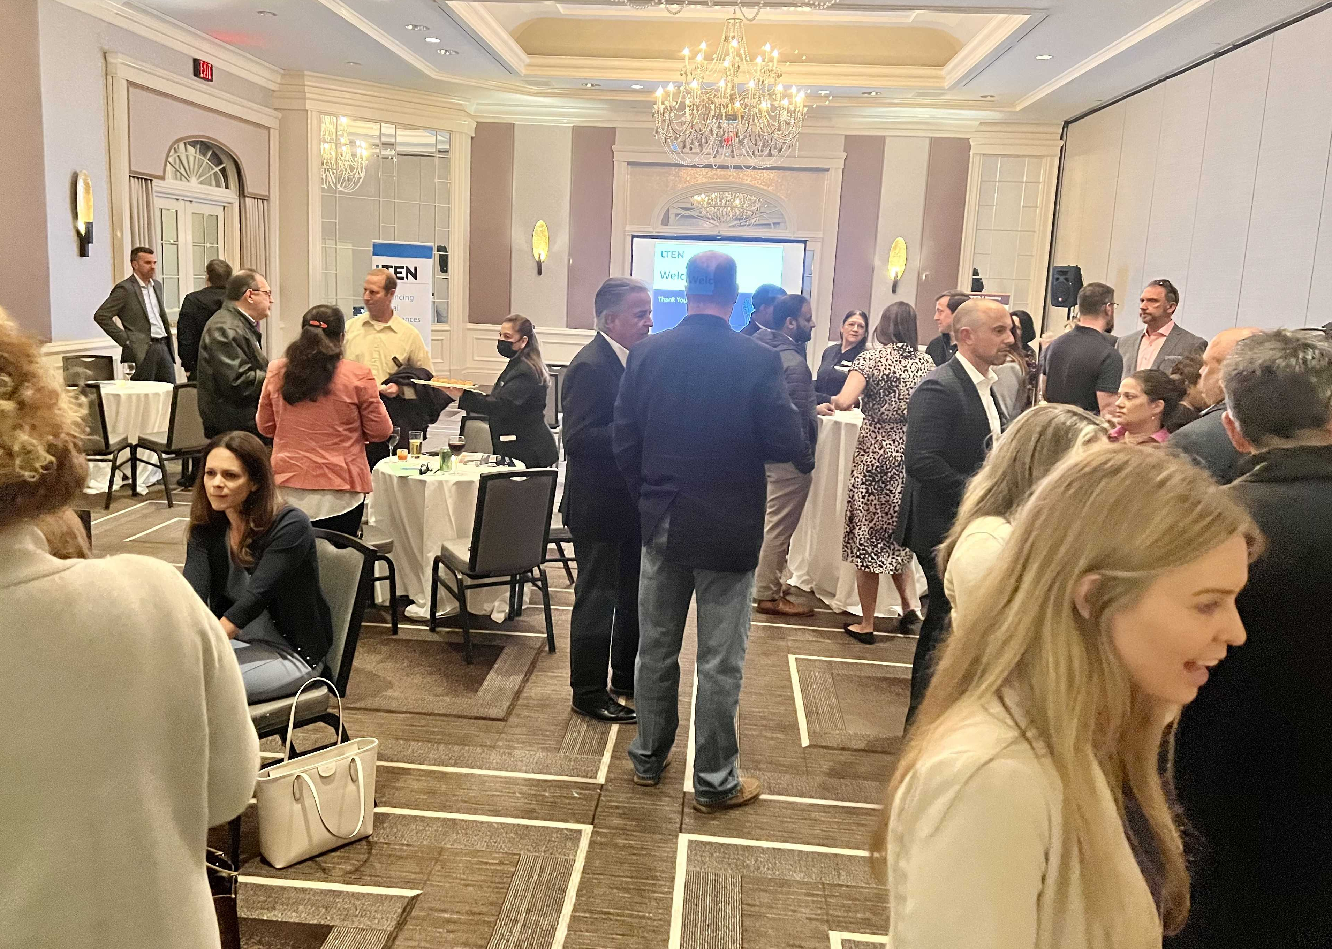
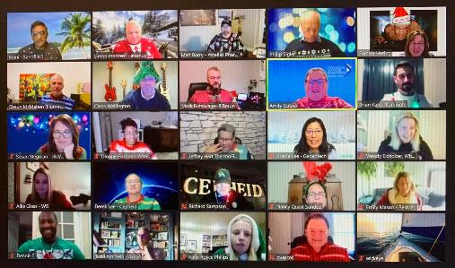
Connections with Industry Peers
Networking Mixers
March 14, 2023 – San Diego, CA
March 28, 2023 – Princeton, NJ
September 12, 2023 - Cambridge, MA
October 11, 2023 – Chicago, IL
October 27, 2023 – Virtual
December 5, 2023 – Short Hills, NJ

Slide 12
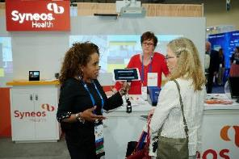
Trusted Industry Partners
Partner Directory
LTEN Annual
Conference
LTEN Partner Previews

Slide 13
A Wealth of Resources
Webinars (Live & On Demand)
Focus On Training Magazine
Bonus Focus Online Articles
IndustryBrief Newsletter
Job Board

Slide 14
LTEN Annual Conference

Slide 15
Corporate Membership Update
Individual
Tier 1
Tier 2
Tier 3
Tier 4
Full Membership at $199 annually and / or Associate Membership at $60 annually
$1,700 annually for up to 10 members
$3,200 annually for up to 20 members
$6,000 annually for up to 40 members
$12,500 annually for unlimited members

Slide 16
Please Let Me Know How I May Help YOU!
Miki White Director, Member Services (540) 725-3859 (540) 330-8270 cell mwhite@L-TEN.org

